Slide 1
BalSat-66 IPET N°66 “Dr. José Antonio Balseiro"

Slide 2

What is our project about?
It consists of an atmospheric probe that simulates a satellite capable of measuring different atmospheric variables. It is launched from a great height and as it falls it measures different atmospheric data. It also has a camera capable of taking atmospheric images every three seconds.

Slide 3
Space Apps Challenge
We chose the “Community Mapping” challenge which involves creatively modeling a community using a spatial representation that incorporates scientific data sets and then using that map to explore how a problem in our community is shaped by the surrounding physical geography.

Slide 4
Our project and the challenge
Our project can take different atmospheric data and atmospheric photographs of the desired area to be able to compare these data over time, uploading the files to a web repository, a program or our Instagram. This idea gives us many applications in our current world, especially in our province, Córdoba, Argentina, where we have different environmental problems.

Slide 5
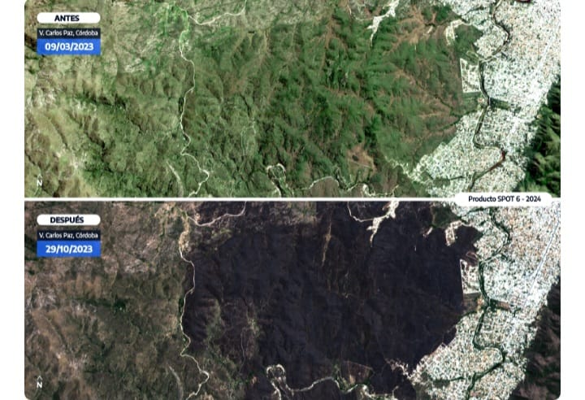
Real problem
In our province, so far this year, fire has consumed 69,500 hectares of native forests. Our project can help by taking images of areas before and after a fire and measuring atmospheric changes. In cities, to observe the increase in urbanization, the increase in temperature and the decrease in air quality. In lakes, dams and rivers, to compare the water level, the amount of algae and pollution with the images. Our satellite is amphibious, it can fall on water without being damaged.
Villa Carlos Paz
Before the fire 03/09/23
After the fire 10/29/23

Slide 6
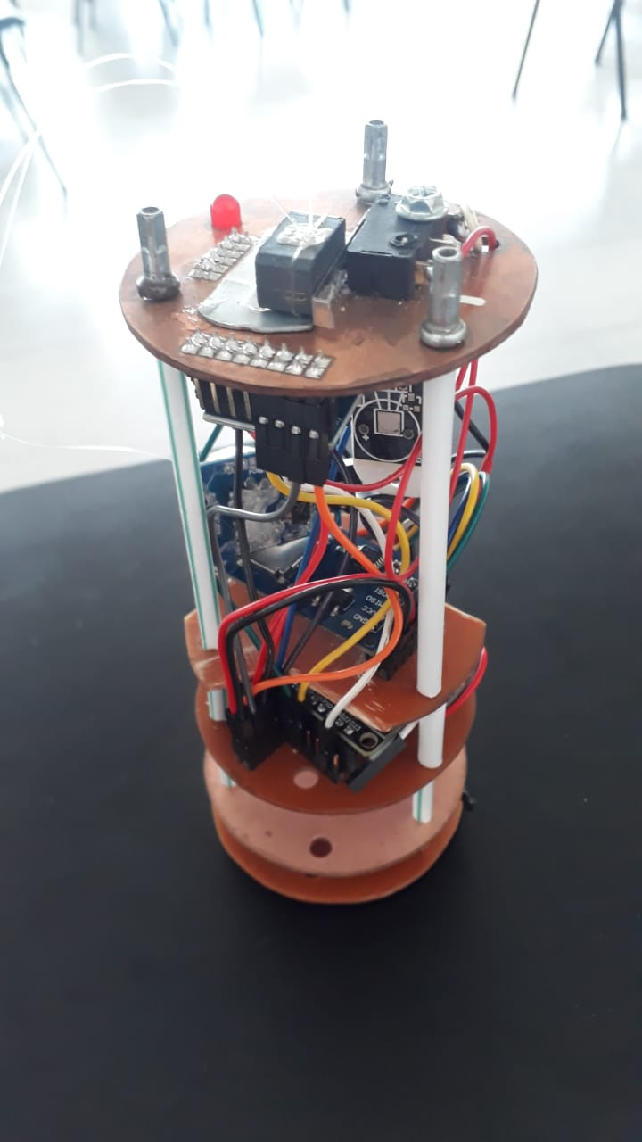
Advantages over other options
The great advantage that our probe has over obtaining data from satellites is the ease of obtaining environmental data and atmospheric images on a scale of any desired location at any time. It is also modular, allowing the addition of other sensors for any application. Whereas satellite images are difficult or impossible to obtain, too expensive and some are dated.
Our probe in production

Slide 7
Thank you for your time!
Sarnago Joaquín - Corte Mauricio - Ortubia Tomás - Gullo Alejandro Contact: balsat66.team@gmail.com
Instagram: balsat.66

